Slide 1
Fiducial Pattern Recognition
The updated algorithm
Methods and Results

Slide 2
Summary
Objectives
New software architecture
New pattern definition
Segmentation
Line finder
Labeling
Results
Future work

Slide 3
Objectives
Main objective: a generic algorithm
Robustness
Computational speed
Efficiency
No code redundancy

Slide 4
New Software Architecture
Pattern Recognition
Common
Pattern Recognition
Segmentation
Line Finder
Labeling
Independency between the major classes of the algorithm.

Slide 5
New Pattern Definition
<Pattern Type="CoplanarParallelWires" Name="Left">
<Wire Name="F1" EndPointFront="60.65 38.0 3.0" EndPointBack="60.65 38.0 103.0" />
<Wire Name="F2" EndPointFront="60.65 48.0 3.0" EndPointBack="60.65 48.0 103.0" />
<Wire Name="F3" EndPointFront="60.65 58.0 3.0" EndPointBack="60.65 58.0 103.0" />
<Wire Name="F4" EndPointFront="60.65 68.0 3.0" EndPointBack="60.65 68.0 103.0" />
<Wire Name="F5" EndPointFront="60.65 78.0 3.0" EndPointBack="60.65 78.0 103.0" />
</Pattern>
<Pattern Type="CoplanarParallelWires" name="Diagonal">
<Wire Name="F5" EndPointFront="60.65 78.0 3.0" EndPointBack="60.65 78.0 103.0" />
<Wire Name="E4" EndPointFront="70.65 68.0 3.0" EndPointBack="70.65 68.0 103.0" />
<Wire Name="D3" EndPointFront="80.65 58.0 3.0" EndPointBack="80.65 58.0 103.0" />
<Wire Name="C2" EndPointFront="90.65 48.0 3.0" EndPointBack="90.65 48.0 103.0" />
<Wire Name="B1" EndPointFront="100.65 38.0 3.0" EndPointBack="100.65 38.0 103.0" />
</Pattern>
<Pattern Type="CoplanarParallelWires" name="Right">
<Wire Name="B1" EndPointFront="100.65 38.0 3.0" EndPointBack="100.65 38.0 103.0" />
<Wire Name="B2" EndPointFront="100.65 48.0 3.0" EndPointBack="100.65 48.0 103.0" />
<Wire Name="B3" EndPointFront="100.65 58.0 3.0" EndPointBack="100.65 58.0 103.0" />
<Wire Name="B4" EndPointFront="100.65 68.0 3.0" EndPointBack="100.65 68.0 103.0" />
<Wire Name="B5" EndPointFront="100.65 78.0 3.0" EndPointBack="100.65 78.0 103.0" />
</Pattern>

Slide 6
Segmentation
Upgrade towards a generic algorithm.
The number of hardcoded values has been greatly reduced.
Use of dynamic containers instead of fixed-size arrays.

Slide 7
Line Finder
Finding n-point lines instead of 3-point lines.
New line definition: Origin + Direction Vector
Divided into two parts:
Find 2-point lines
Find n-point lines

Slide 8
Find 2-point Lines
Smarter computation: not all 2-point lines are computed:

Slide 9
Find n-point Lines
Not all n-point lines are computed, only the ones matching strict criteria:

Slide 10
Labeling
Now searching for patterns made of any number of n-point lines.
Several parameters are taken in account
Distance of parallel lines

Slide 11
Labeling
Now searching for patterns made of any number of n-point lines.
Several parameters are taken in account
Common Point

Slide 12
Labeling
Now searching for patterns made of any number of n-point lines.
Several parameters are taken in account
Shift

Slide 13
Labeling
A permutation is created to select a unique triplet of lines. E.g. looking for a pattern containing 3 lines and we have 5 candidate lines:
0 1 2
0 1 3
0 1 4
0 2 3
0 2 4
1 2 3
1 2 4
1 3 4
2 3 4
The previous parameters are checked for each pair of lines of the permutation:
0 1
0 2
1 2

Slide 14
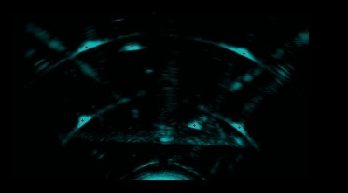
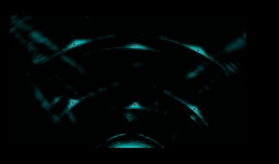
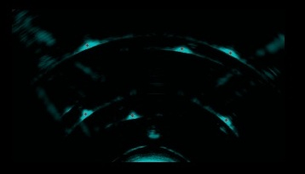
Results Translation Data

Slide 15
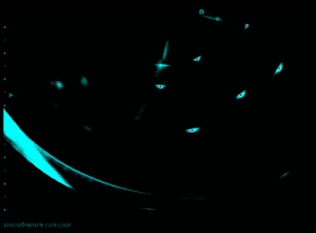
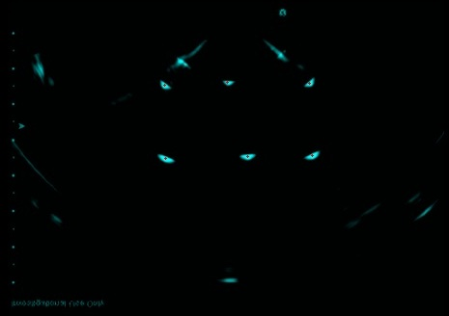
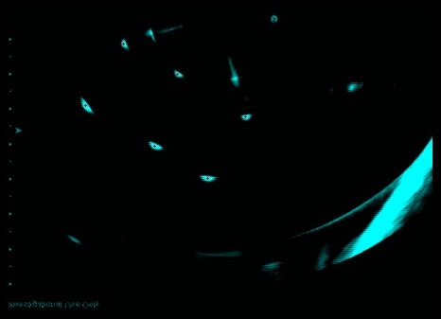
Results Rotation Data

Slide 16
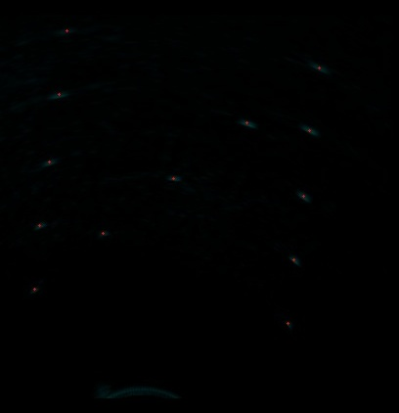
Results CIRS Phantom Model 45

Slide 17
Results
Dataset | Former algorithm runtime (s) | New algorithm runtime (s)
Translation | 7.04 | 7.77
Random stepper motion 1 | 4.73 | 4.96
Random stepper motion 2 | 2.28 | 2.82
Rotation 1 | 20.25 | 3.07
Rotation 2 | 3.57 | 4.16
CIRS phantom 045 | - | 2.15
Slight slow down for most cases.
Excellent speed-up for worst case.

Slide 18
Future Work
Make the segmentation more generic by using other methods for the morphological operations (ITK?)
Reduce the number of checks in the Labeling which can be significant for patterns containing more lines.
Change the permutations to compute the best n-uplet first (highest intensity?)

Slide 19
Questions
Thank you

